Slide 1


Software Engineering
Binisa R.,
Computer Science and Engineering

Slide 2
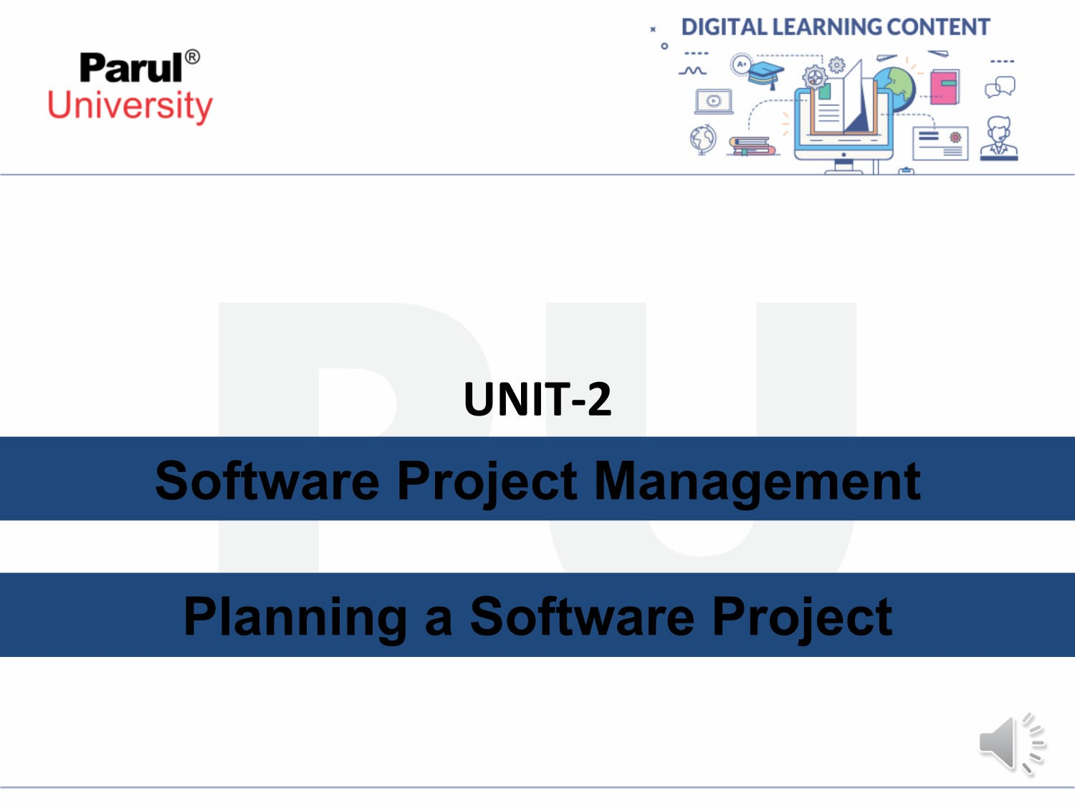
Software Project Management
Planning a Software Project

Slide 3
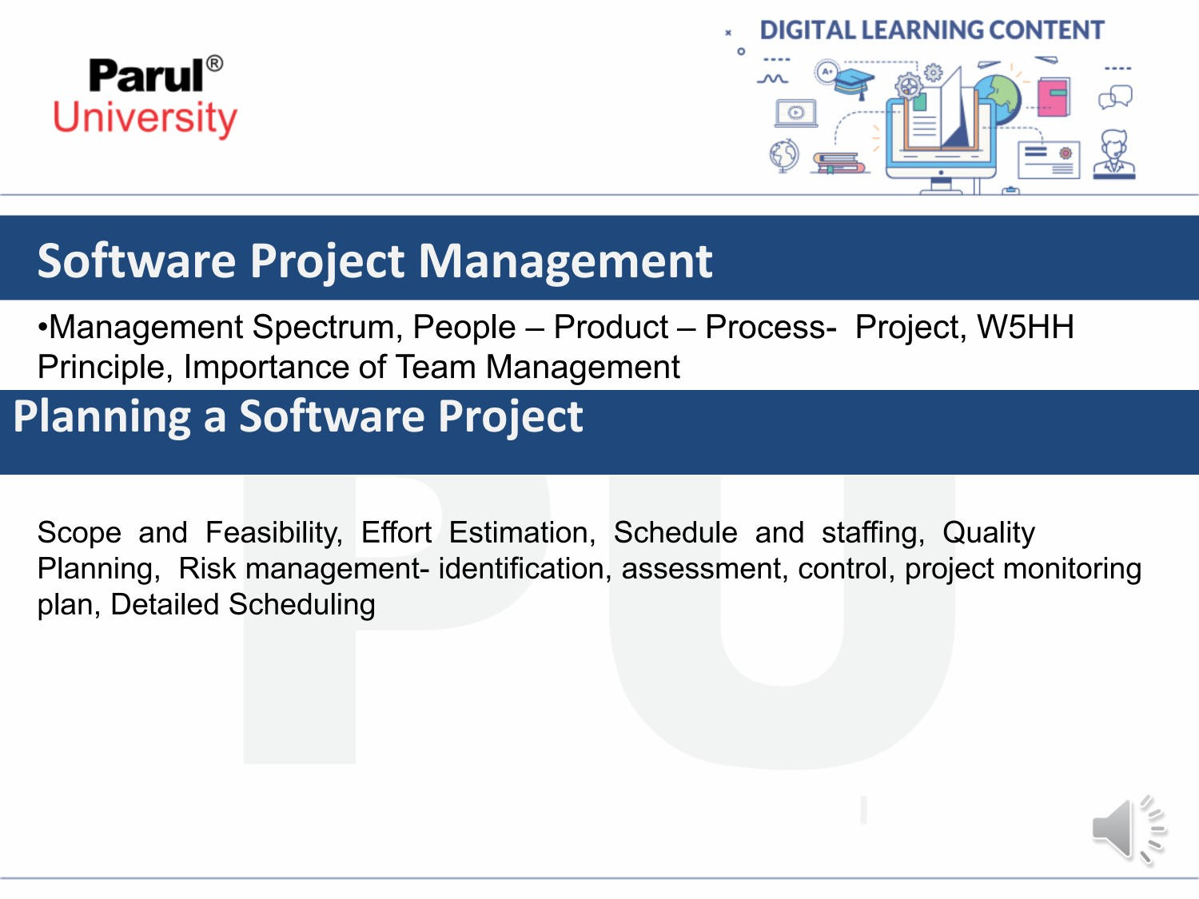
Software Project Management
Planning a Software Project

Slide 4

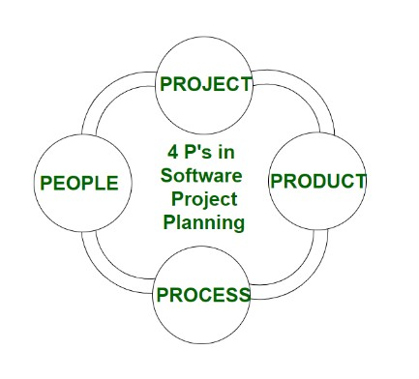
Software Project Management
Management Spectrums
For properly building a product, there’s a very important concept that we all should know in software project planning while developing a product. There are 4 critical components in software project planning which are known as the 4P’s namely:
Product
Process
People
Project

Slide 5
People-Product-Process-Project
People The most important component of a product and its successful implementation is human resources. In building a proper product, a well-managed team with clear-cut roles defined for each person/team will lead to the success of the product. We need to have a good team in order to save our time, cost, and effort. Some assigned roles in software project planning are project manager, team leaders, stakeholders, analysts, and other IT professionals. Managing people successfully is a tricky process which a good project manager can do.
Product As the name inferred, this is the deliverable or the result of the project. The project manager should clearly define the product scope to ensure a successful result, control the team members, as well technical hurdles that he or she may encounter during the building of a product. The product can consist of both tangible or intangible such as shifting the company to a new place or getting a new software in a company.

Slide 6
People-Product-Process-Project
Process In every planning, a clearly defined process is the key to the success of any product. It regulates how the team will go about its development in the respective time period. The Process has several steps involved like, documentation phase, implementation phase, deployment phase, and interaction phase.
Project The last and final P in software project planning is Project. It can also be considered as a blueprint of process. In this phase, the project manager plays a critical role. They are responsible to guide the team members to achieve the project’s target and objectives, helping & assisting them with issues, checking on cost and budget, and making sure that the project stays on track with the deadlines.

Slide 7
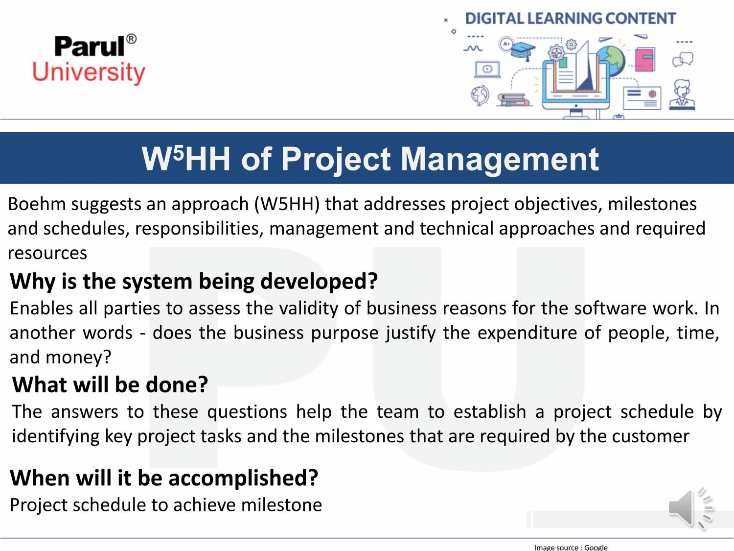
W5HH of Project Management

Slide 8
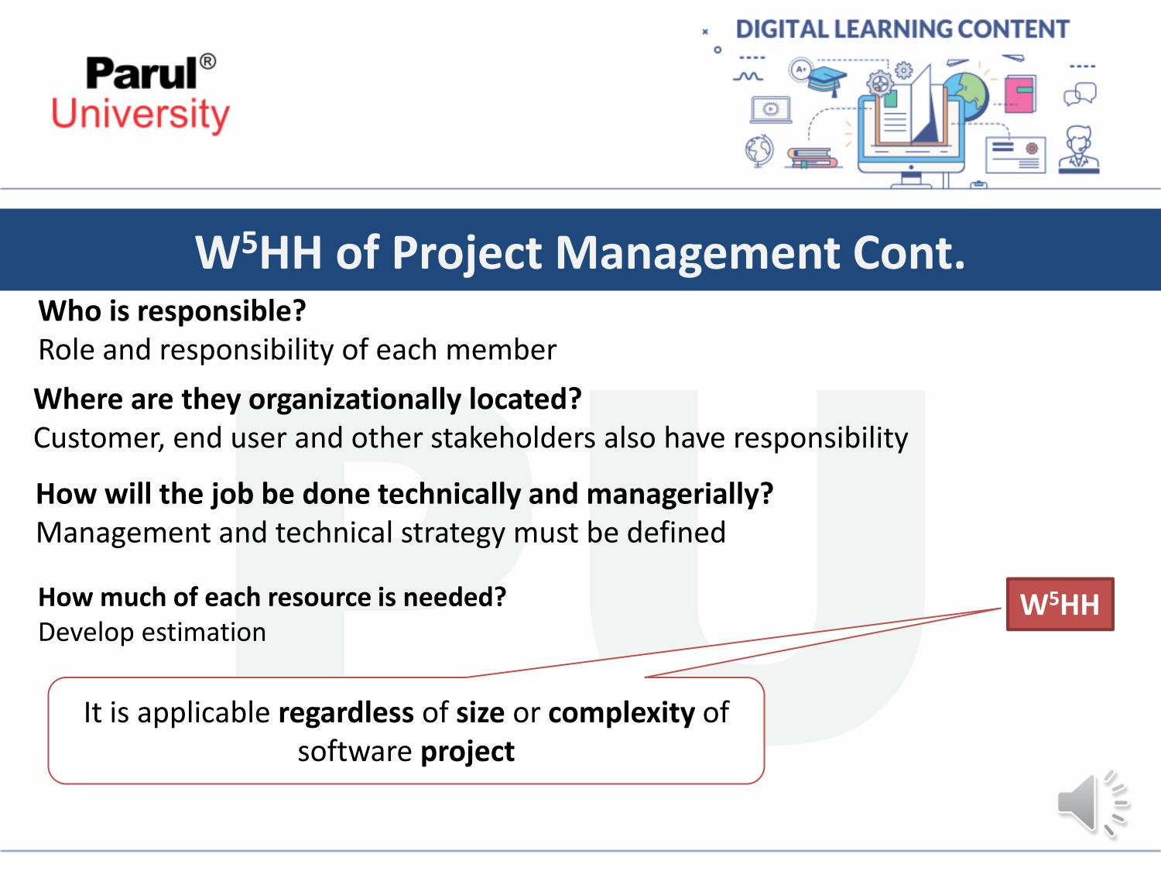
W5HH of Project Management

Slide 9

Importance of Team Management
Importance of Team Management

Slide 10
Importance of Team Management
Team management is crucial in software engineering for several reasons:
Boosts Productivity and Efficiency: A well-managed team fosters collaboration and communication, which helps developers avoid duplication of efforts and ensures everyone is on the same page. This leads to a smoother development process and faster completion of projects.
Enhances Quality: Through code reviews, knowledge sharing, and collective problem-solving, teams can identify and fix bugs more effectively. This leads to higher quality software with fewer errors.
Promotes Innovation: Diverse perspectives and skillsets within a team can spark creativity and lead to innovative solutions. Effective team management encourages these contributions from individual members.

Slide 11
Importance of Team Management
Increases Morale: A supportive and positive team environment keeps developers motivated and engaged. Team managers who address conflicts effectively and recognize achievements contribute to a happier and more productive workforce.
Reduces Turnover: When developers feel valued, supported, and challenged, they are more likely to stay with the company. Good team management practices can help retain talent and reduce the costs associated with recruiting and onboarding new developers.
In short, effective team management is essential for getting the most out of your software engineering team. It leads to a more productive, efficient, and innovative team that produces high-quality software.

Slide 12
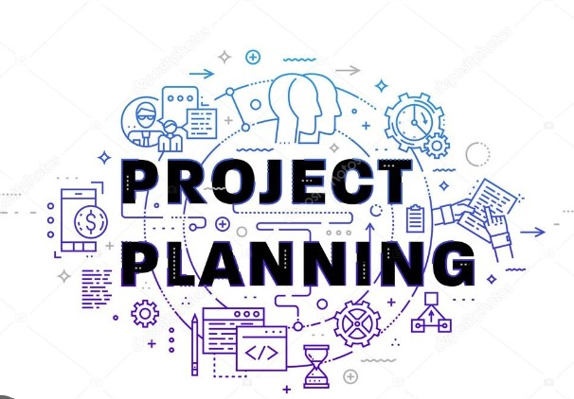
Project Planning
Project Planning

Slide 13
Project Planning
In software engineering, scope and feasibility are two intertwined concepts that determine the success of a project.
Scope:
Refers to all the features and functionalities that will be included in the final software product.
It defines the boundaries of the project, what it will do, and what it won't do.
A well-defined scope ensures everyone involved (developers, clients, stakeholders) is on the same page about the project's deliverables.

Slide 14
What is Scope in Project Management?
During the time of eliciting and framing the requirements of a Project, it is important to understand
the key domains that our project would influence. This is important, not only for the evaluation of the project but also, for assuring that the project adheres to the requirements and industry standards.
The Scope of a Project encapsulates all this information in a structured way so all the stakeholders
can understand what is the Project and how it will create an impact on the various dimensions.
What is the Project Scope?
The Scope is the part of the Project Management that is responsible for the boundaries, objectives, and deliverables
of the Project. In other words, it is the total amount of activities or tasks that need to be done under the Project Execution.
It includes all the information about the breakdown of the project tasks and deliverables so that they can be easily managed.
Defining the Project’s scope is an integral part of the project definition and execution phase.
Thus, it plays a crucial role in highlighting the precise objectives of the Project
Scope

Slide 15
Project Scope Management Steps :
1. Plan Scope Management:
This initial step involves creating a roadmap for how you'll manage scope throughout the project.
This plan outlines the tools, techniques, and roles involved in scope definition, verification, and control.
2. Collect Requirements:
This involves gathering information from stakeholders (clients, users) about their needs and expectations for the software.
Techniques like workshops, interviews, and user story gathering help capture these requirements.
3. Define Scope:
Based on the collected requirements, this step translates them into a detailed description of the project's functionalities and deliverables.
The scope statement becomes a key document outlining what the project will and will not include.
Scope Management

Slide 16
4. Create WBS (Work Breakdown Structure):
The WBS breaks down the project scope into smaller, more manageable tasks.
Imagine a hierarchical structure where the project goal sits at the top, and each level below further decomposes the work into smaller and more specific deliverables.
5. Verify Scope:
This step involves formalizing the agreement on the defined scope.
Stakeholders typically review the scope statement and WBS to ensure it aligns with their expectations.
Once approved, a baseline is established to serve as a reference point for future comparisons.
6. Control Scope:
Throughout the project, this step ensures that the project stays within the defined scope.
It involves monitoring progress, identifying any potential scope creep requests, and managing changes.
A change control process is typically defined to evaluate and approve or reject any proposed scope changes, considering their impact on time, budget, and resources.
Scope Management

Slide 17
Scope Management
Why is Project Scope Management important?
Defines Project Boundaries
Sets Clear Objectives
Guided Decision Making
Facilitates Planning
Manages Stakeholder Expectations

Slide 18
Feasibility
In software engineering project management, feasibility refers to the process of assessing whether a proposed software project is realistic and achievable within the given constraints. It's like evaluating the viability of a project before diving headfirst into development.
There are five main types of feasibility studies considered during this assessment:
Technical Feasibility:
This examines whether the project can be built with the current technology and resources available.
It considers factors like:
Existing hardware and software capabilities
Team's technical expertise
Availability of necessary tools and technologies

Slide 19
Economic Feasibility:
This focuses on the financial viability of the project.
It involves a cost-benefit analysis, considering:
Development costs (salaries, tools, infrastructure)
Maintenance costs
Projected return on investment (ROI)
The goal is to determine if the project is financially sound and aligns with the organization's budget.
Operational Feasibility:
This evaluates how well the software will integrate with existing workflows and infrastructure.
It considers:
The impact on current operations and how users will adapt to the new system
The maintainability and scalability of the software after deployment
Feasibility

Slide 20
Feasibility
Feasibility
Legal Feasibility:
This ensures the project complies with all relevant laws and regulations.
It considers:
Data privacy regulations
Intellectual property rights
Licensing requirements
Schedule Feasibility:
This assesses whether the project can be completed within the planned timeframe.
It considers:
Project complexity
Team size and workload
Resource availability

Slide 21
Feasibility
Here's an example:
Imagine a company wants to develop a mobile app with cutting-edge features using a brand new programming language. A feasibility study might reveal that the technical expertise for this language is scarce and expensive (technical feasibility). Additionally, the development costs might outweigh the projected user base (economic feasibility). Based on this, the company might choose to scale back on the features or explore alternative technologies that better suit their resources and budget.

Slide 22
Effort Estimation
In software project management, effort estimation is the practice of predicting the amount of time and resources required to complete a software development project. It's essentially trying to forecast the workload involved in bringing your project to life.
Why Effort Estimation is Important:
Realistic Planning: Accurate effort estimates help create achievable project timelines and resource allocation plans. This prevents underestimating the workload and potential delays.
Improved Budgeting: By knowing the estimated effort (often translated to person-hours), project managers can create more realistic budget forecasts.
Client Communication: Having effort estimates allows for transparent communication with clients about project costs and timelines.
Risk Management: The estimation process can uncover potential bottlenecks or under-resourced areas, allowing for proactive risk mitigation strategies.

Slide 23
Effort Estimation
Types of Effort Estimation Techniques:
There are various techniques used for effort estimation, each with its own strengths and weaknesses. Here are some common approaches:
Expert Judgment: Leveraging the experience of senior developers or project managers to provide estimates based on past projects or similar functionalities.
Delphi Technique: An iterative process where a group of experts anonymously provide estimates, receive feedback on the aggregate results, and then revise their estimates until a consensus is reached.
Analogy-Based Estimation: Estimating effort based on historical data from similar projects. This requires a good understanding of past projects and the ability to identify relevant similarities.
Bottom-Up Estimation: This involves breaking down the project into smaller tasks, estimating the effort for each individual task, and then summing them up to get the overall project effort.
Top-Down Estimation: This starts with a high-level estimate for the entire project and then allocates effort to different functionalities or features.

Slide 24
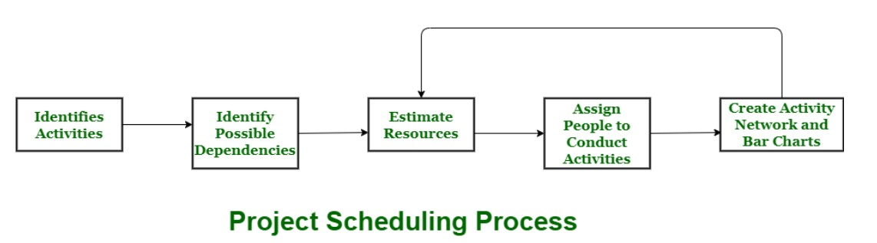
Schedule and staffing
Project Scheduling
A schedule in your project’s time table actually consists of sequenced activities and milestones that are needed to be delivered under a given period of time.
Project schedule simply means a mechanism that is used to communicate and know about that tasks are needed and has to be done or performed and which organizational resources will be given or allocated to these tasks and in what time duration or time frame work is needed to be performed. Effective project scheduling leads to success of project, reduced cost, and increased customer satisfaction. Scheduling in project management means to list out activities, deliverables, and milestones within a project that are delivered. It contains more notes than your average weekly planner notes. The most common and important form of project schedule is Gantt chart.

Slide 25
Project Scheduling
Project Scheduling Process
Estimate Resources: Assess the resources required for each activity, such as personnel with specific skillsets, software, and hardware.
Assign People to Activities: Allocate the identified resources (people) to the tasks they're best suited for.
Identify Dependencies: Determine the relationships between tasks. Some tasks can't commence until others are completed (e.g., you can't test a feature until it's developed).
Identify Activities: This involves listing all the essential tasks required to complete the project.
Create Network and Bar Charts: Visualize the project schedule using tools like network diagrams and bar charts. These charts depict the task dependencies and timelines.

Slide 26
Staffing Process
The project staffing process in software engineering is all about finding the right people with the right skills to
fill the specific roles required for a successful project. It's like assembling a team with complementary strengths to ensure all aspects of the development process are covered efficiently.
Project Planning and Needs Assessment:
This initial phase involves defining the project scope and functionalities. Based on these requirements,
the team identifies the necessary skills and experience needed to complete the project.
2. Recruitment:
Once the required skillsets are identified, the recruitment process begins. This might involve:
Posting job descriptions on internal or external job boards.
Utilizing staffing agencies to source candidates.
Leveraging employee referrals within the company.

Slide 27
Effort Estimation
3. Selection:
Qualified candidates are interviewed by technical leads or hiring managers to assess their technical skills, experience with relevant technologies, and cultural fit within the team.
4. Evaluation and Offer:
Based on interviews and potentially technical assessments, the top candidates are evaluated, and offers are made. This might involve salary negotiations and discussions about the project details.
5. Onboarding:
Once a candidate accepts the offer, the onboarding process begins. This involves introducing the new team member to the company culture, project details, tools, and technologies used.

Slide 28
Quality Planning
In software engineering, quality planning is like making a roadmap to ensure the final product is awesome! It's all about thinking ahead and planning how to make sure the software works well, is easy to use, and doesn't have any bugs.
Here's the gist of it:
Imagine the perfect software: Think about what features it should have and how users will interact with it.
2. Set the standards: Decide what "quality" means for this specific project. Is it speed? User-friendliness? Reliability?
3. Plan how to check the quality: Figure out how you'll test the software throughout development to catch any issues early on.
4. Think about what could go wrong: Identify potential problems and brainstorm ways to prevent them.
5. Keep improving: Quality planning isn't a one-time thing. As the project progresses, you might need to adjust your plans to ensure the software keeps getting better.

Slide 29
Risk management
What is Risk Management?
Risk Management is a systematic process of recognizing, evaluating, and handling threats or risks that have an effect on the finances, capital, and overall operations of an organization. These risks can come from different areas, such as financial instability, legal issues, errors in strategic planning, accidents, and natural disasters.
Why is risk management important?
Risk management is important because it helps organizations to prepare for unexpected circumstances that can vary from small issues to major crises. By actively understanding, evaluating, and planning for potential risks, organizations can protect their financial health, continued operation, and overall survival.
Let’s Understand why risk management important with an example.
Suppose In a software development project, one of the key developers unexpectedly falls ill and is unable to contribute to the product for an extended period.
One of the solution that organization may have , The team uses collaborative tools and procedures, such as shared work boards or project management software, to make sure that each member of the team is aware of all tasks and responsibilities, including those of their teammates.
An organization must focus on providing resources to minimize the negative effects of possible events and maximize positive results in order to reduce risk effectively. Organizations can more effectively identify, assess, and mitigate major risks by implementing a consistent, systematic, and integrated approach to risk management.

Slide 30
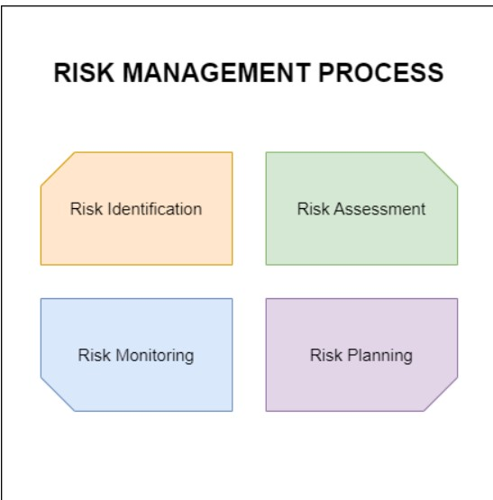
Risk management
The risk management process
Risk management is a sequence of steps that help a software team to understand, analyze, and manage uncertainty. Risk management process consists of :
Risks Identification.
Risk Assessment.
Risks Planning.
Risk Monitoring

Slide 31
Risk management
1.Risk Identification:
This initial stage involves brainstorming and actively searching for potential threats that could negatively impact your project. The goal is to come up with a comprehensive list of risks across various categories like project scope, technical challenges, resource limitations, or external factors.
2. Risk Assessment:
Once risks are identified, you need to evaluate their likelihood (how probable it is to occur) and impact (how severe the consequences would be if it does occur). A common approach assigns a rating (e.g., High, Medium, Low) for both likelihood and impact. By multiplying these ratings, you get a risk score that helps prioritize risks. Focus on addressing risks with the highest scores first.
3. Risk Planning:
After assessing risks, it's crucial to develop a plan to manage them. There are four main approaches:
Avoid: If possible, eliminate the risk altogether by changing the project approach or requirements.

Slide 32
Risk management
Mitigate: Reduce the likelihood or impact of the risk. This might involve implementing additional testing procedures or having a backup plan in case a team member leaves.
Transfer: Shift the risk to a different party (e.g., using an insurance policy for hardware failure).
Accept: Acknowledge the risk and have a contingency plan in place to deal with it if it occurs.
4. Risk Monitoring:
Risk management is not a one-time activity. Throughout the project lifecycle, continuously monitor identified risks. Reassess their likelihood and impact as project conditions change, and be prepared to adjust your mitigation plans as needed.
By following these steps, software engineering teams can proactively identify and address potential issues, improve project outcomes, and deliver successful software products.

Slide 33
Control
What is Control Phase in Project Management?
In project management, the control stage refers to taking corrective measures using data collected during monitoring. It seeks to keep the project on track and in line with its purpose by resolving issues, minimizing risks, and adopting appropriate modifications into plan documents for projects.
Purpose
Implement Corrective Actions: Using the issues, risks, or deviations from the project plan as a pretext to implement corrective actions and put back on course.
Adapt to Changes: Accommodate changes in requirements, external parameters or unknown circumstances by altering project plans resources and strategies.
Optimize Resource Utilization: Do not allow the overruns of resources or lack thereof that directly affect project performance.
Ensure Quality and Compliance: Comply with quality standards, regulatory mandates and project policies to achieve the best results possible.
Facilitate Communication: Communicate changes, updates and resolutions to the stakeholders in order to preserve transparency and cooperation through project.

Slide 34
Control
Tools and Technologies for Control
Project Management Software: It is possible to adjust project plans, schedules and tasks using Microsoft Project Jira or Trello depending on changes identified in the control phase.
Change Control Tools: ChangeScout, Prosci or integrated change management modules within project management software allow for systematic changes.
Collaboration Platforms: Instruments such as Microsoft Teams, Slack or Asana enhance interaction and cooperation; the platforms allow real-time information sharing between team members.
Version Control Systems: To control changes to project documentation and maintain versioning, Git or Subversion tools are necessary.
Quality Management Tools: Quality control activities are facilitated by tools such as TestRail, Jira and Quality Center to make sure the project deliverables meet predetermined quality standards.
Risk Management Software: Tools like RiskWatch, RiskTrak or ARM (Active risk Management) help in monitoring and controlling risks helping to implement the mitigation strategies on risks.
Resource Management Tools: There are tools such as ResourceGuru, LiquidPlanner or Smartsheet that contribute to optimizing resource allocation and easing adjustments in the control phase.
Communication Platforms: Communication tools like Zoom, Microsoft Teams or Slack make it possible to inform the stakeholders of changes, updates and resolutions in a timely manner.

Slide 35
Monitoring
What is Monitoring phase in project management?
Monitoring in project management is the systematic process of observing, measuring, and evaluating activities, resources, and progress to verify that a given asset has been developed according to the terms set out. It is intended to deliver instant insights, detect deviations from the plan, and allow quick decision-making.
Purpose
Track Progress: Monitor the actual implementation of the project along with indicators such as designs, timelines budgets, and standards.
Identify Risks and Issues: Identify other risks and possible issues in the early stage to create immediate intervention measures as well as resolutions.
Ensure Resource Efficiency: Monitor how resources are being distributed and used to improve efficiency while avoiding resource shortages.
Facilitate Decision-Making: Supply project managers and stakeholders with reliable and timely information for informed
Enhance Communication: Encourage honest team communication and stakeholder engagement related to project status, challenges

Slide 36
Monitoring
Tools and Technologies for Monitoring
Project Management Software: Tools such as Microsoft Project, Jira, and Trello offer features in terms of scheduling monitoring resources for task execution.
Performance Monitoring Tools: The solutions that New Relic, AppDynamics and Dynatrace provide cater to monitoring of application performances as well as infrastructure performance besides user experience.
Network Monitoring Tools: The three tools namely SolarWinds Network Performance Monitor, Wireshark and PRTG Network monitor help in monitoring and analyzing the network performance.
Server and Infrastructure Monitoring Tools: The mentioned monitoring tools, namely Nagios prometheus and Zabbix monitor servers systems and IT infrastructure for performance availability.
Log Management Tools: Log analysis and visualization are performed using ELK Stack (Elasticsearch, Logstash, Kibana), Splunk, and Graylog.
Cloud Monitoring Tools: Amazon CloudWatch, Google Cloud Operations Suite, and Azure Monitor provide monitoring solutions for cloud-based services and resources.
Security Monitoring Tools: Security Information and Event Management tools like Splunk, IBM QRadar or ArcSight provide support to the process of monitoring security events and incidents.

Slide 37
Detailed Scheduling
Detailed scheduling in software engineering dives deeper than high-level project timelines. It focuses on meticulously planning and managing the sequence and duration of individual tasks within a project. Here's a quick breakdown:
Think microscopic, not macroscopic: While project scheduling sets the overall project timeline, detailed scheduling breaks down that timeline into smaller, more manageable chunks.
Focus on task dependencies: It identifies the relationships between tasks. Some tasks can't start until others are finished (e.g., testing can't happen before development).
Accurate effort estimation: Detailed scheduling involves precisely estimating the time and resources required for each specific task.
Resource allocation: Matches specific resources (developers, testers) with tasks based on their skills and the schedule requirements.
Enhanced project control: Allows for closer monitoring of progress, proactive identification of potential delays, and real-time adjustments to the schedule.

Slide 38
Detailed scheduling
Example:
Imagine building a house. Project scheduling might define the overall timeframe for completion. Detailed scheduling would involve outlining all the individual steps, like laying the foundation, framing the walls, and installing electrical wiring, with specific timelines and resource allocation for each task.

Slide 39


